Slide 1


Slide 2
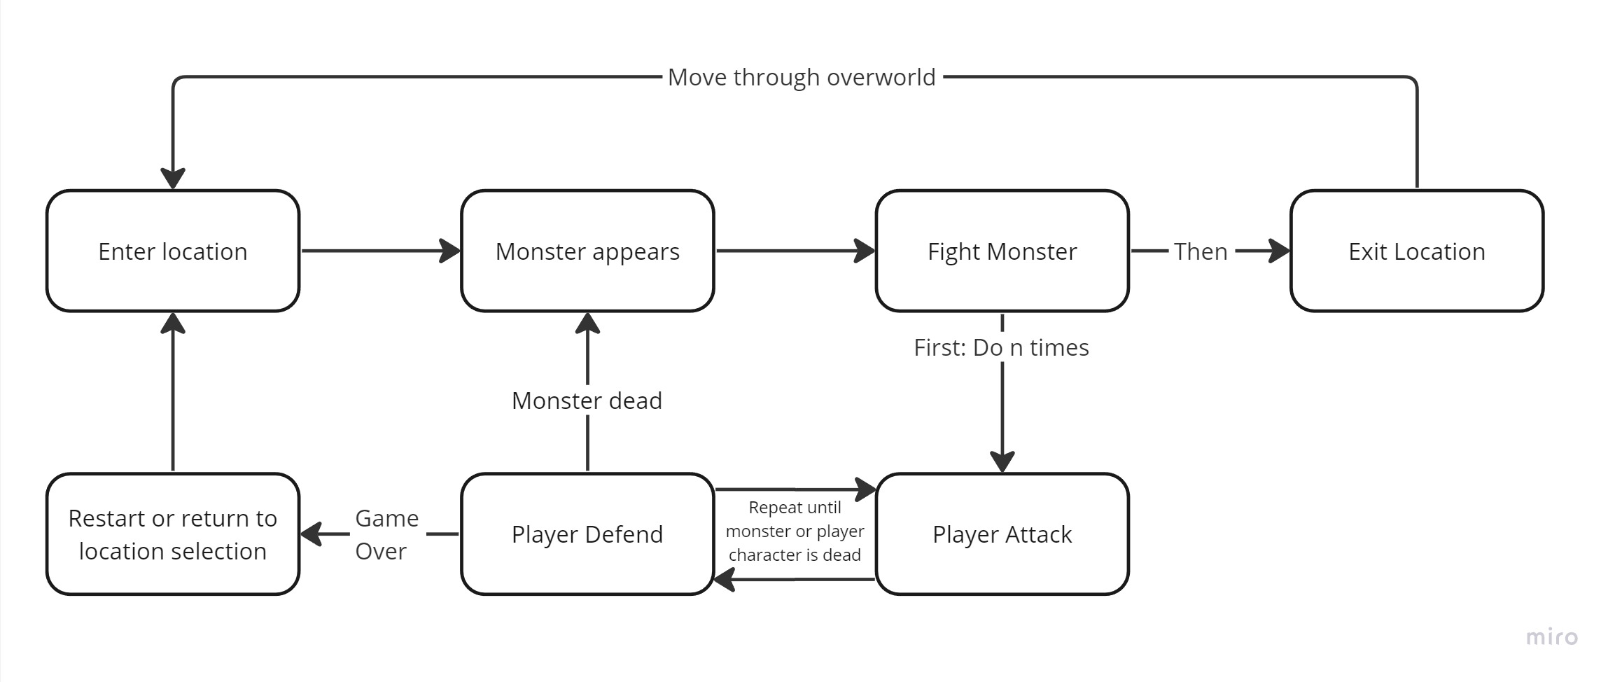
Core Loop

Slide 3
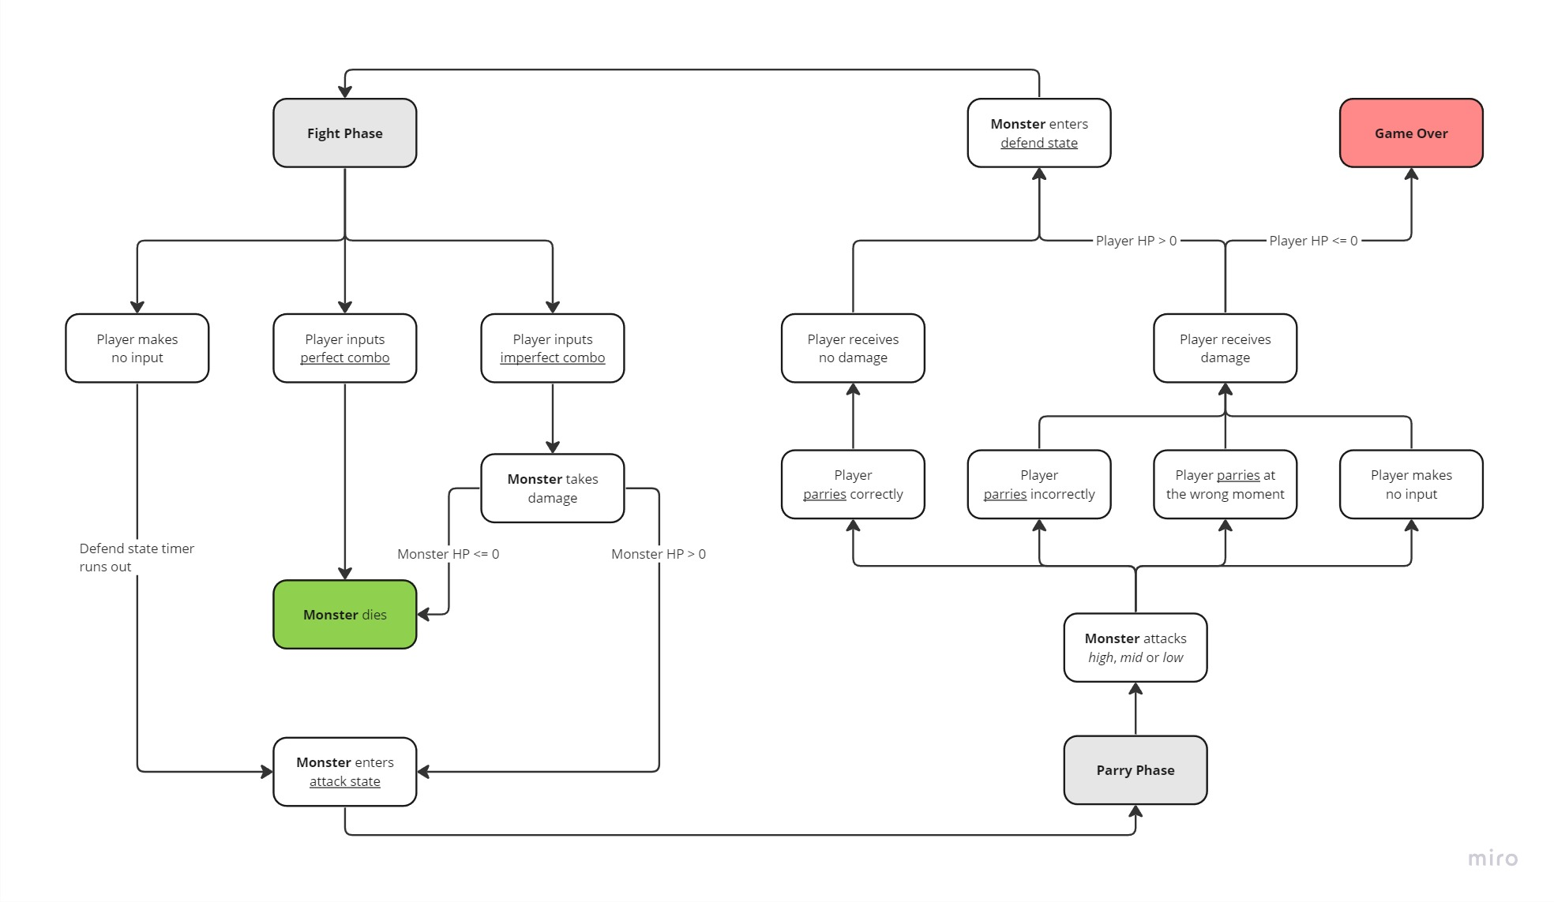

Slide 4
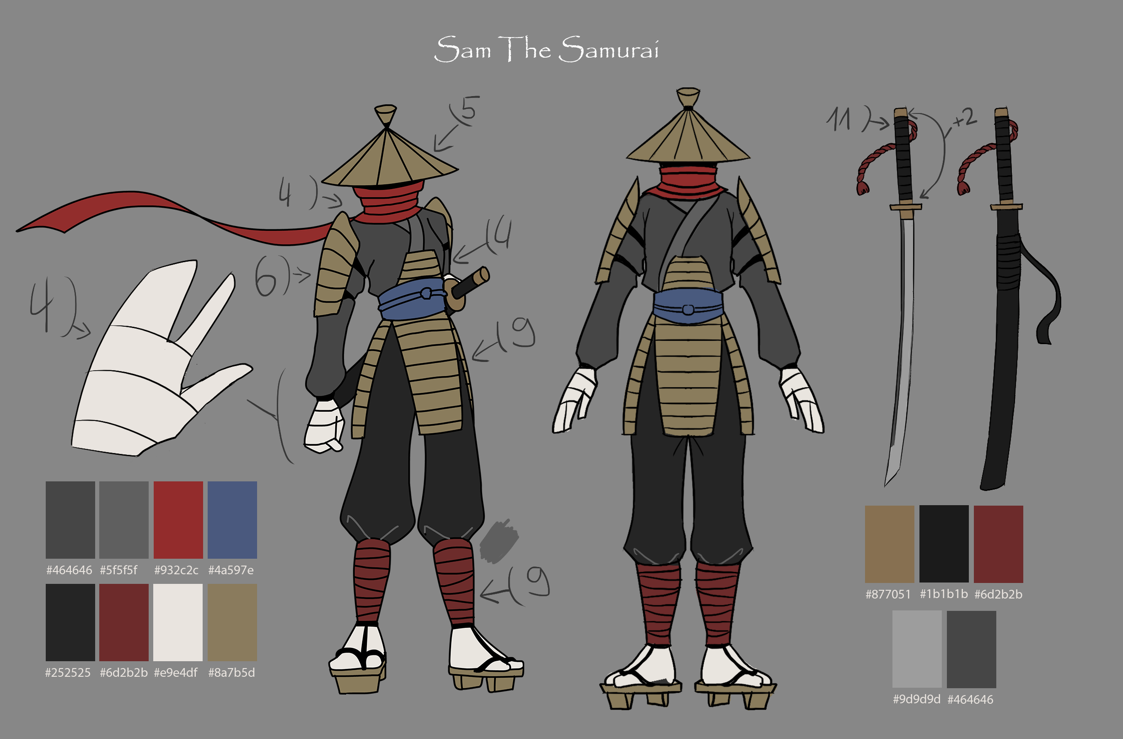
Player Character

Slide 5
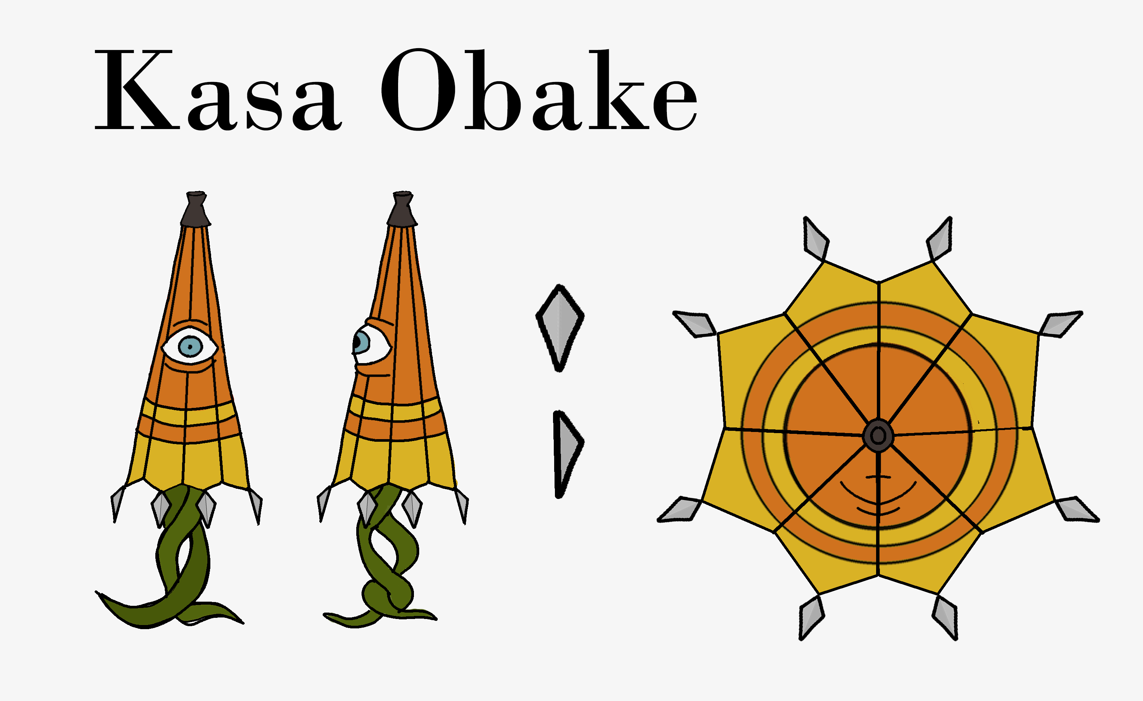
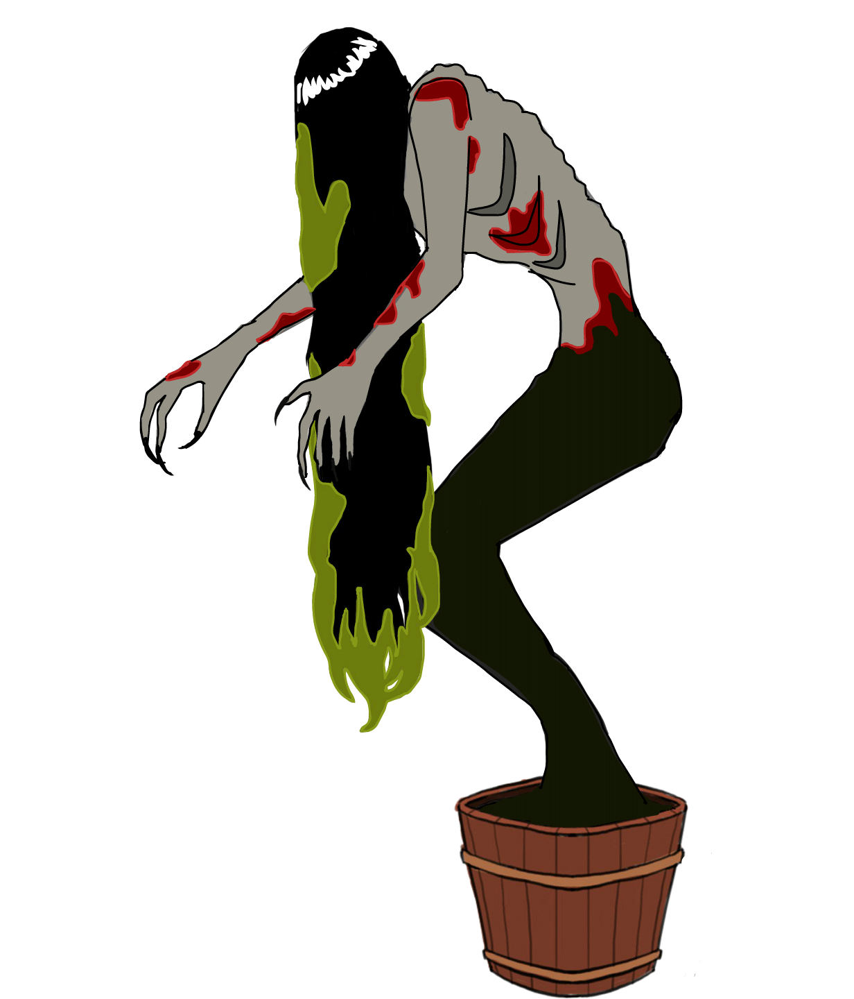
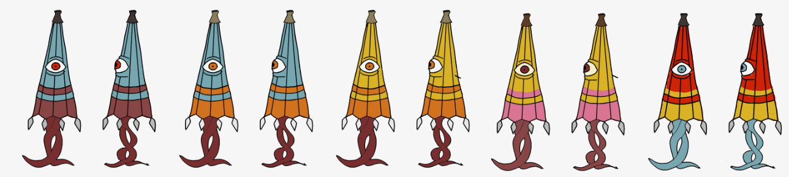
Enemies

Slide 6
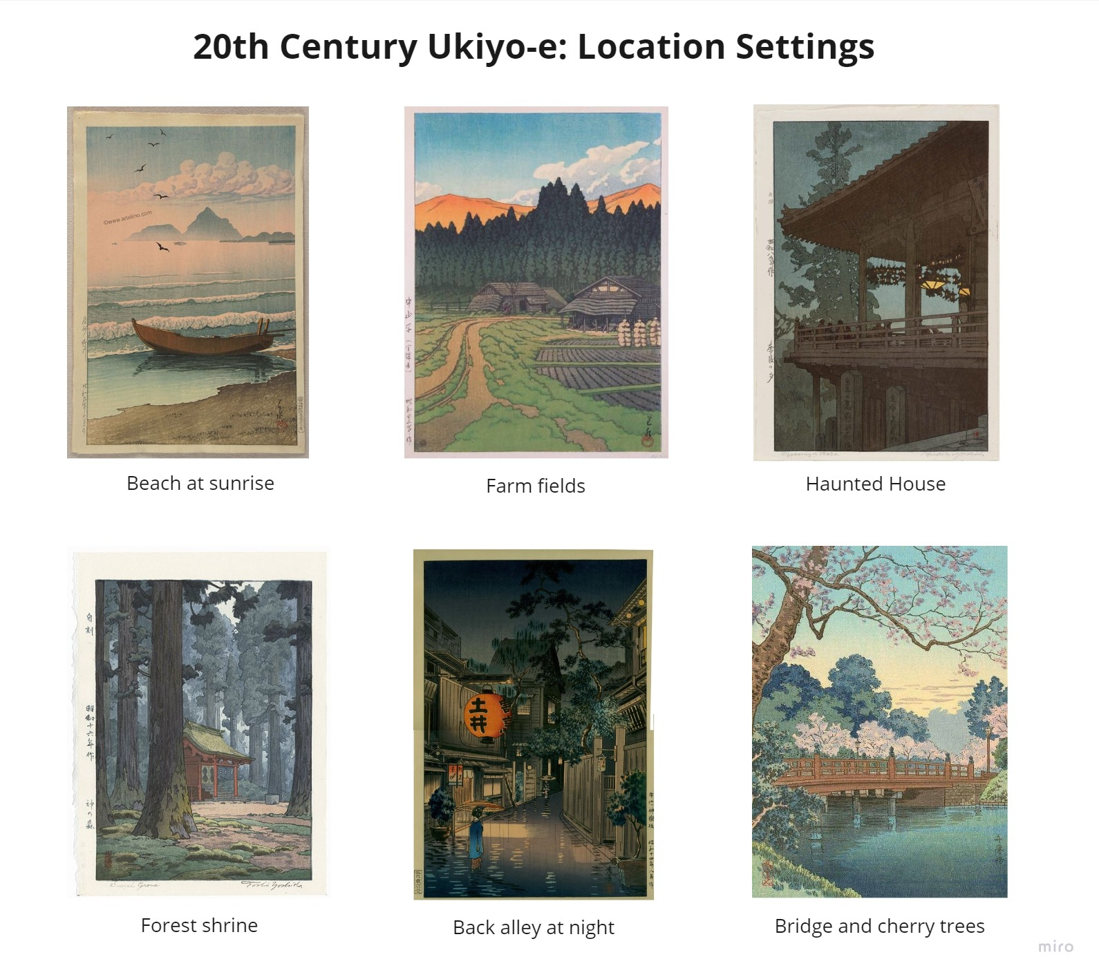
Locations

Slide 7
Scope
Must Have | Should Have | Nice to Have
Swiping Combat Mechanic ✔ | Particle Effects WIP | Bosses NYS
Enemies x3 ✔/ WIP | Adaptive UI WIP | Enemies x15 Enemies x6
Player Character ✔ | Overworld NYS | Level x10 Level x3
Animated WIP | Score ✔/ WIP | Items
Level x1 WIP | Stylized Shaders (Environment) ✔ | Achievements NYS
SFX ✔/ WIP | Traditional Instrumentation WIP | Unlockables (Skins) NYS
 | Unique Monster Sounds WIP
Final Feature List

